Slide 1
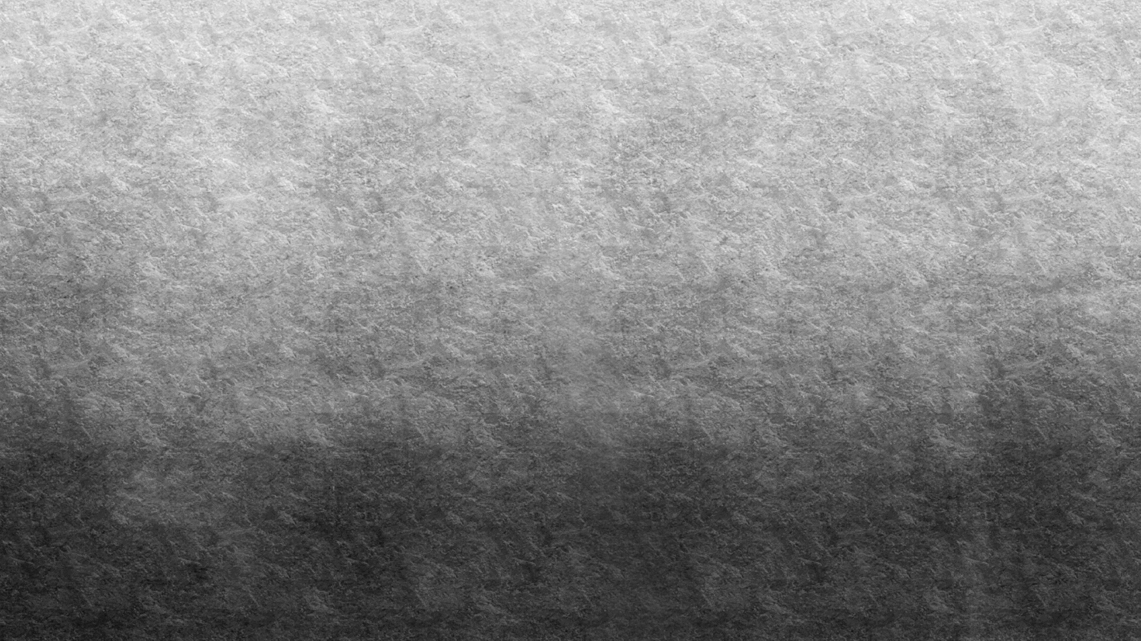
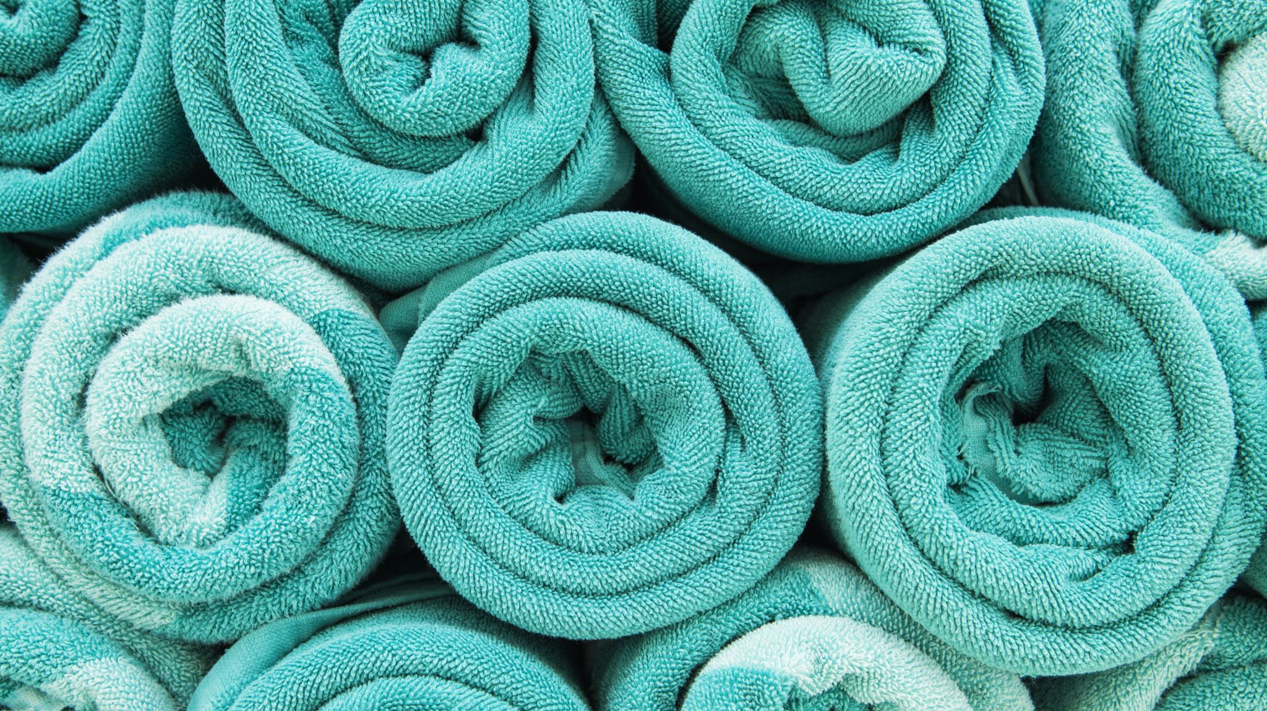
Body Progress Microfiber Gym Towels
Larry Baucum
12/15/23
CTEC-415

Slide 2
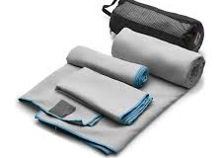
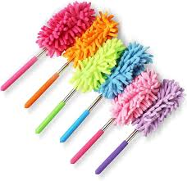
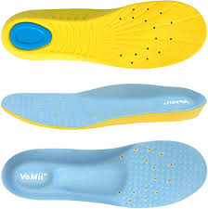
Potential Products
Microfiber Gym Towel
Microfiber Duster
Memory Foam Insoles

Slide 3
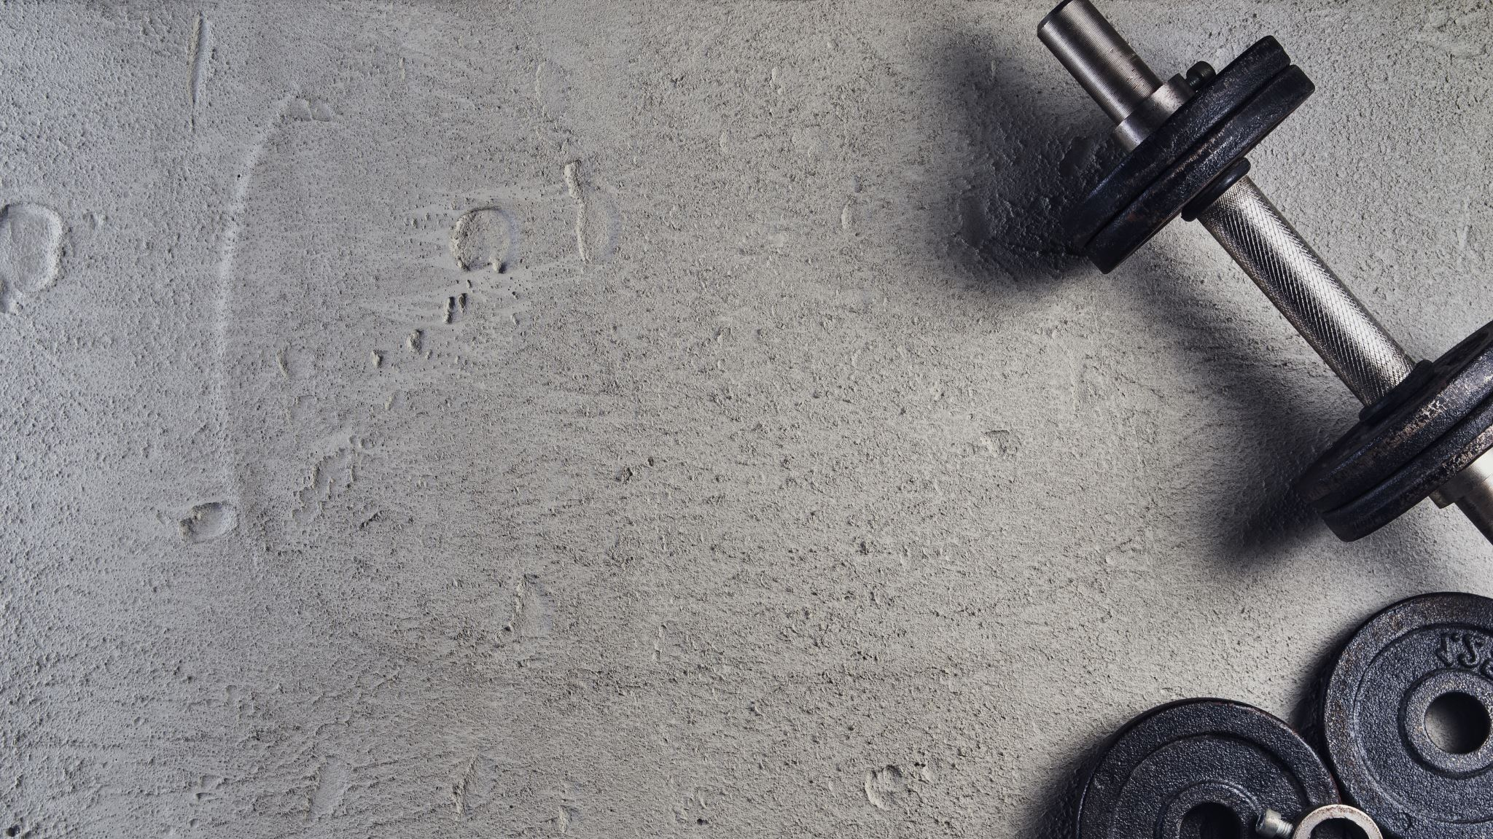
Selection Process
I chose the microfiber gym towel over my other potential products because it is the most versatile and relevant. Fitness and health are popular now and a gym towel felt like an easy-to-sell essential item. A gym towel can technically be used for many different things making it more versatile than insoles or a duster. I believe the microfiber gym towel once proven will advertise and sell itself to many different demographics.

Slide 4
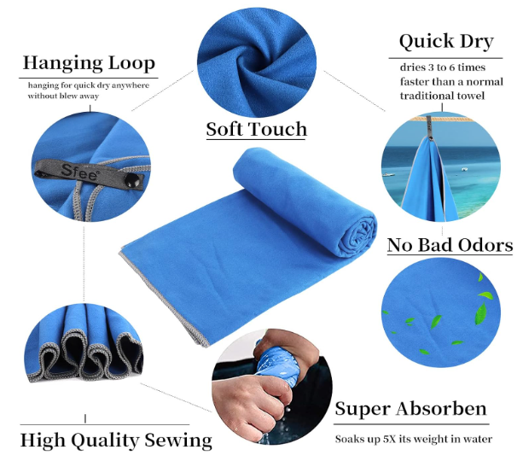
Product Description
My product is a medium-sized microfiber gym towel that comes with a loop and carrying bag in multiple colors. The dimensions for my product will be 30L x 16W in a rectangular shape.
My towel features quick drying, high water absorption, a soft feel, no lingering odors, and long-lasting material.
Even though the towel is advertised for exercise it’s versatile and can replace any traditional towel functions.
The accompanying loop allows for quick storage of the towel, whether that’s storing in the provided carrying bag or to be hung up for quick drying.

Slide 5

Product Differentiation
Upon searching through 3-star reviews for similar microfiber gym towels a common trend became apparent. Most customers had issues with excessive color bleed during washing and water retention.
To address the issue of color bleed I decided to go with a higher-quality microfiber material that will last long and bleed less during washing.
Water retention will be handled by using higher-quality materials and by having an %70 polyester and %30 polyamide blend. The benefits of this blend are a soft and durable product that has high absorption and low water retention.

Slide 6
Root Keywords
My first keyword is portable. Portability allows for my product to be available for use no matter the location or use at that location.
My second is fitness. Fitness is a buzzword that gets people’s attention in the fitness and health era we live in. Everyone wants to eat and do things that have healthy buzzwords associated with them to improve their health.
My final root keyword is sweat-absorbing. Sweat-absorbing makes my product available to anyone who frequently sweats, whether it’s for work, exercise, or general activity.

Slide 7
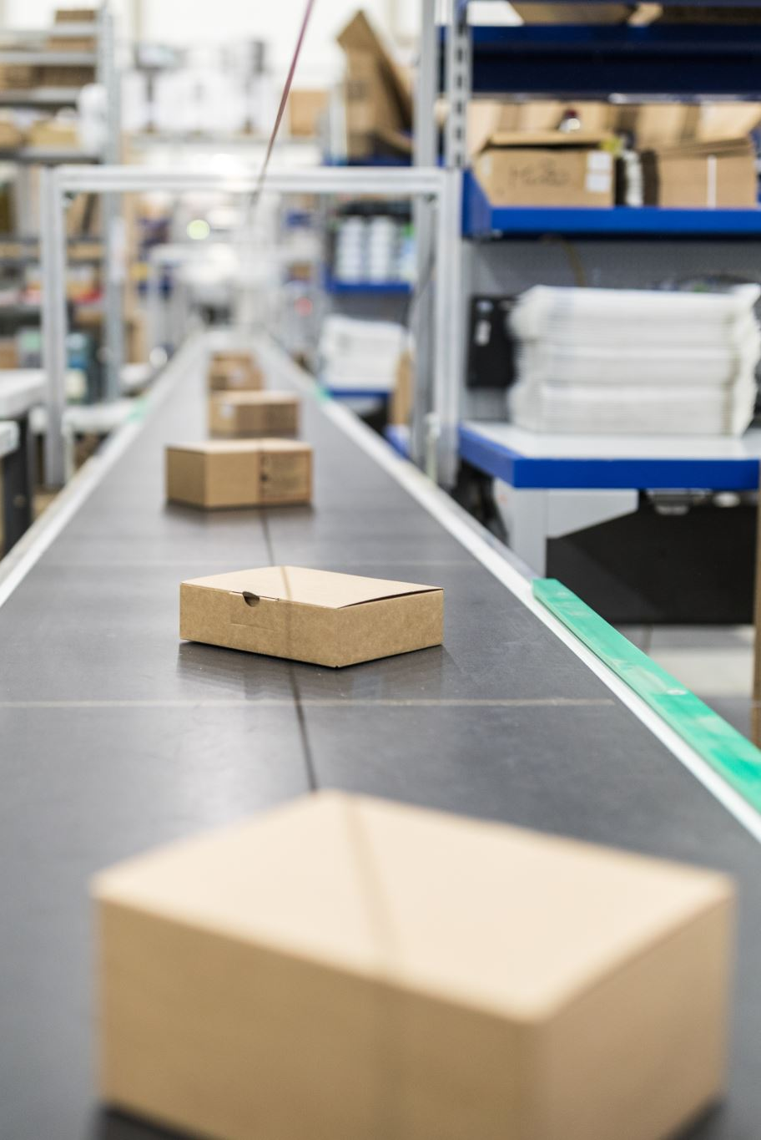
Supplier
My criteria for choosing a supplier came down to a few things which are material quality, customization options, and reliability of shipping and product quality.
I chose Wuxi East-Sunshine Textile CO., LTD. because they have a good reputation with customers, many options for customization of the product and its accessories, and premium materials.
Their pricing while being competitive with other suppliers is more than affordable for their premium quality facility and materials.

Slide 8
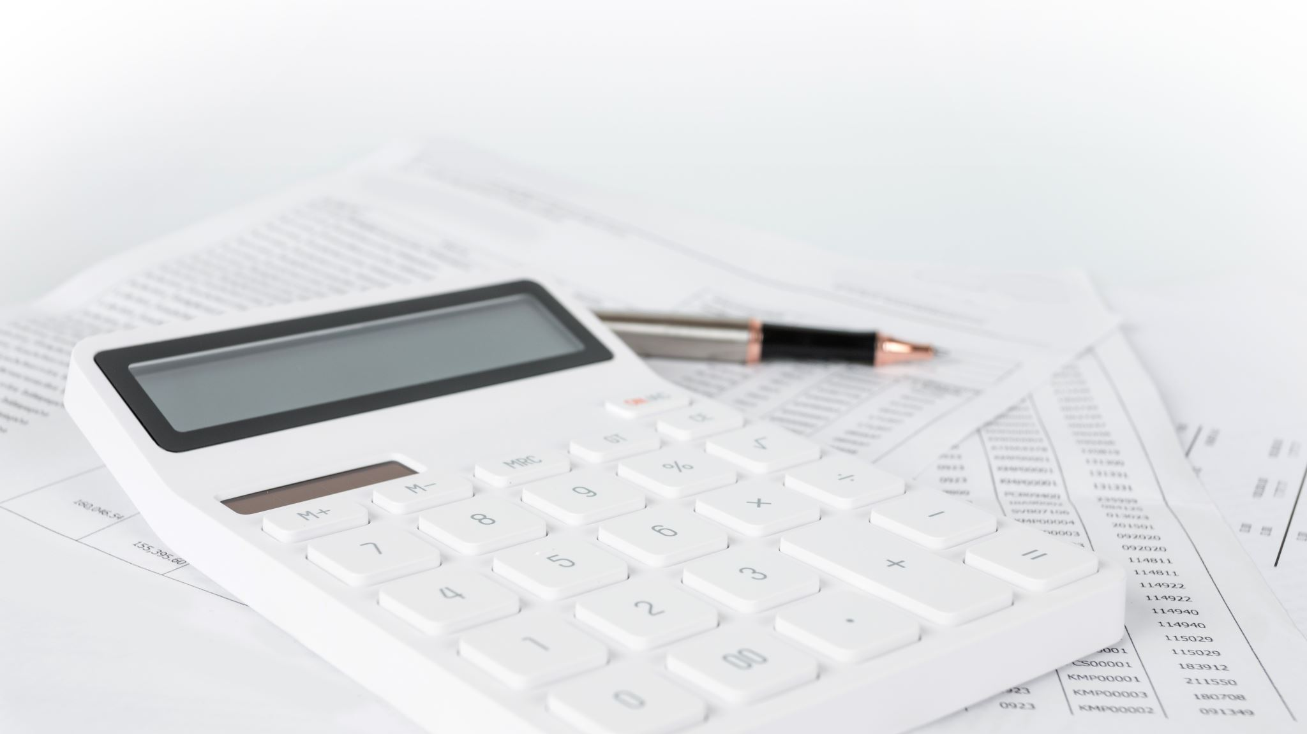
Potential Profit
From my Amazon research I chose similar items with low, medium, and high sales over the last month.
I noticed sales ranging from 100 to 800 to 4,000 on the low, medium, and high sales respectively.
The supplier price is $1.08 per item.
Taking order fulfillment, supplier costs, and Amazon fees into account I came up with a $16.50 price point for two medium-sized towels with a carrying bag and loops.
Using the low-end monthly sales value I would see a profit of $4.13 per sale, which is a %25 profit.
My monthly revenue assuming I could make 100 sales would be $413.

Slide 9
References
https://www.alibaba.com/product-detail/Custom-Ultra-absorbent-Microfiber-Gym-Towels_1600690512176.html?spm=a2700.shop_cp.16319.6.444219e7Jrk18P
https://www.amazon.com/Youphoria-Outdoors-Microfiber-Quick-Travel/dp/B01LYH76YW/ref=sr_1_10?crid=2BLEW96PCWUVY&keywords=microfiber+gym+towel&qid=1702373017&sprefix=microfiber+gym+towel%2Caps%2C262&sr=8-10
https://www.amazon.com/OlimpiaFit-Towels-Microfiber-Perfect-Sports/dp/B07PG8SY25/ref=sr_1_6?crid=2BLEW96PCWUVY&keywords=microfiber%2Bgym%2Btowel&qid=1702373017&sprefix=microfiber%2Bgym%2Btowel%2Caps%2C262&sr=8-6&th=1
https://www.amazon.com/Acteon-Microfiber-Odor-Free-Multipurpose-Lightweight/dp/B081TQB6BC/ref=sr_1_8?crid=2BLEW96PCWUVY&keywords=microfiber%2Bgym%2Btowel&qid=1702373017&sprefix=microfiber%2Bgym%2Btowel%2Caps%2C262&sr=8-8&th=1
https://www.amazon.com/Sfee-Microfiber-Absorbent-Lightweight-Towels-Fit/dp/B07J4W18B9?th=1

